Slide 1
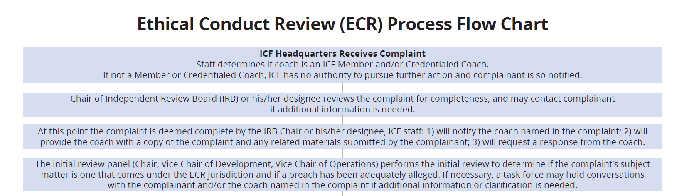
ECR Process Flow Chart

Slide 2
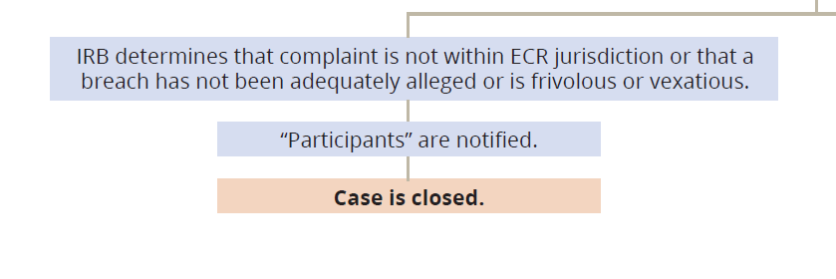
ECR Process Flow Chart

Slide 3
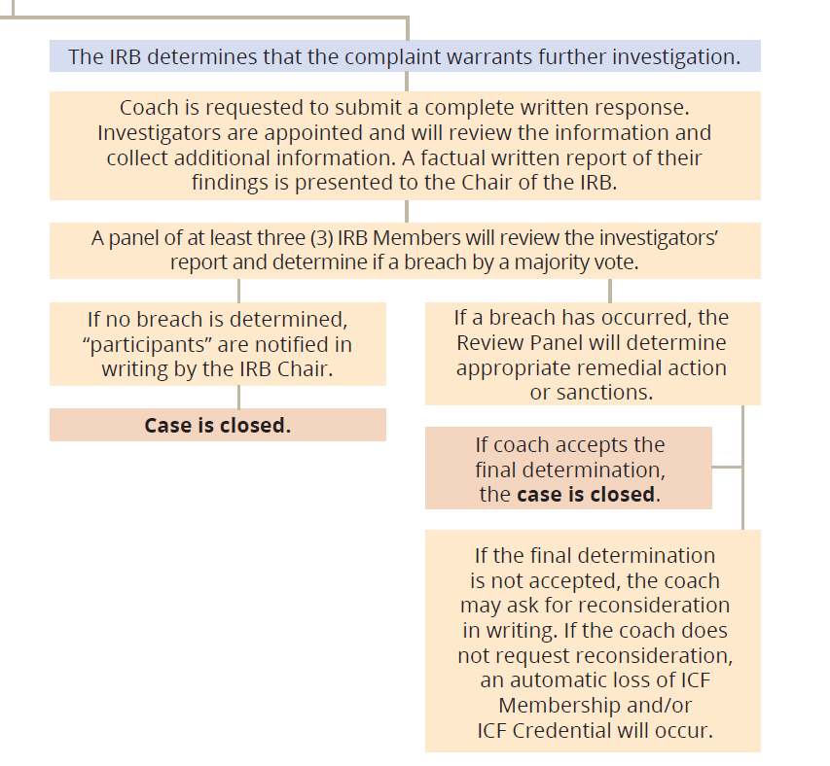
ECR Process Flow Chart

